Slide 1

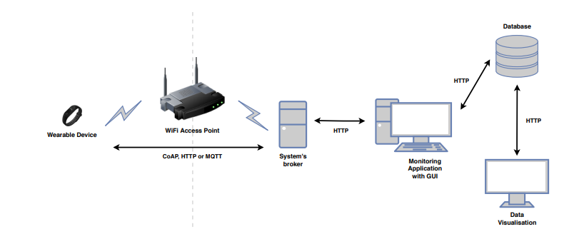
Remote Biometrics, Temperature and Humidity Monitoring System via IoT
For Patients and healthcare organization

Slide 2

Motivation for the proposed project
Since there are large number of patients in hospital and it is physically not possible to observe each patient individually. Due to this some of the casual cases develop complications and become emergency cases. So, in order to observe each patients' biometrics more conveniently I decided to make a project for monitoring biometrics of a patient and temperature and humidity around the patient, which can be observed through OM2M server .
The data collected through this project can be used to study the changes of biometrics before and after any health complication and this data can be used to Predict the health conditions and treatment before hand .
This will also help in analyzing how environmental factor (temperature &humidity) surrounding patients affect their health conditions.

Slide 3
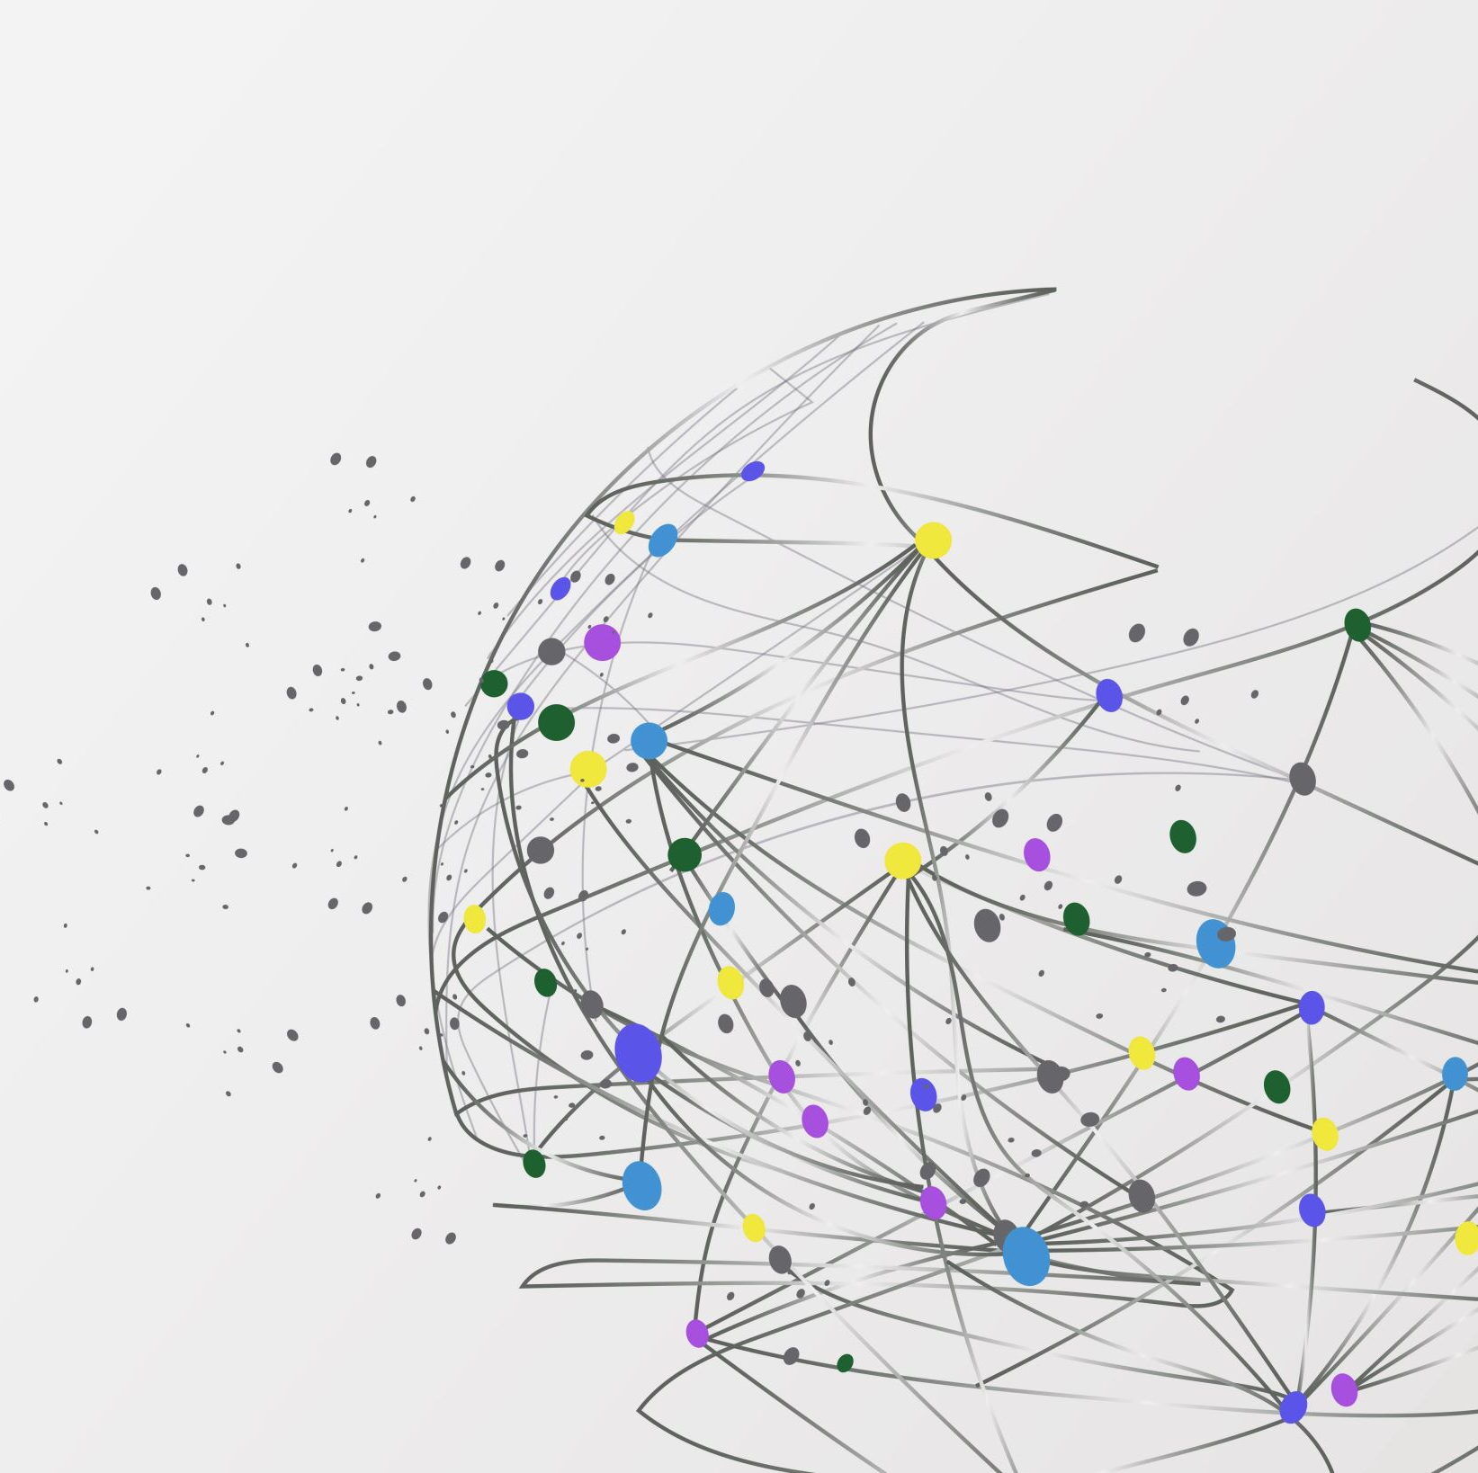
List of required components
Pulse rate oximeter
ESP 32
OLED display
DHT11
Breadboard
Wires & Resistor
Software used:
Arduino IDE
OM2M
Web Dashboard(HTML/THINGSPEAK)

Slide 4
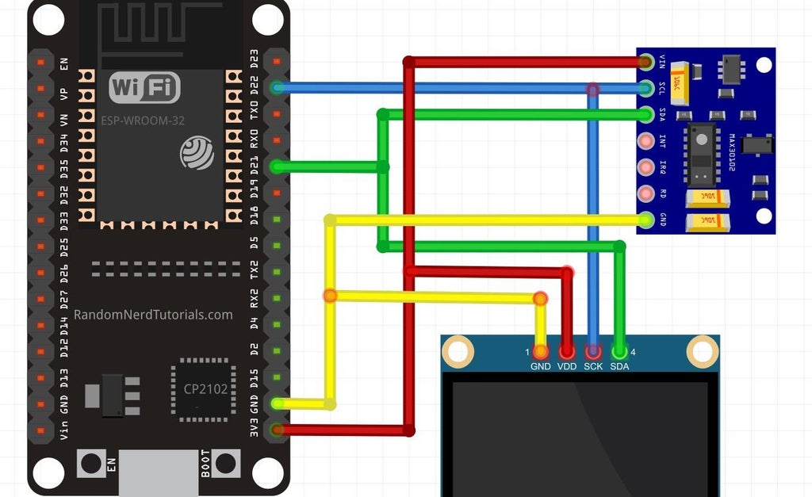
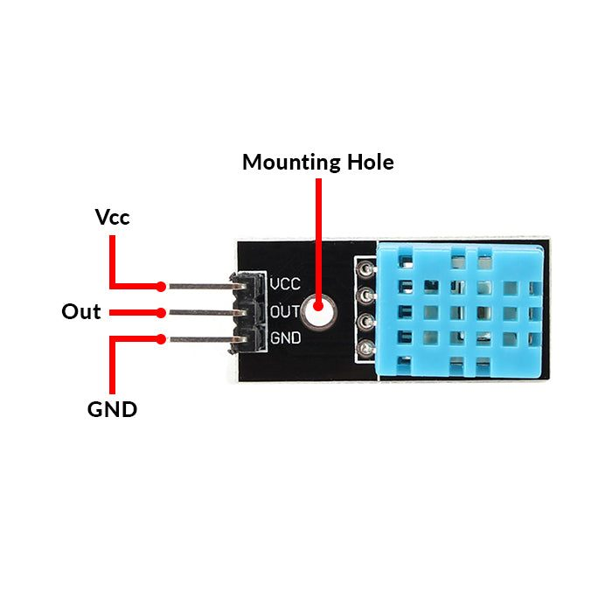
Block diagram of the proposed system

Slide 5
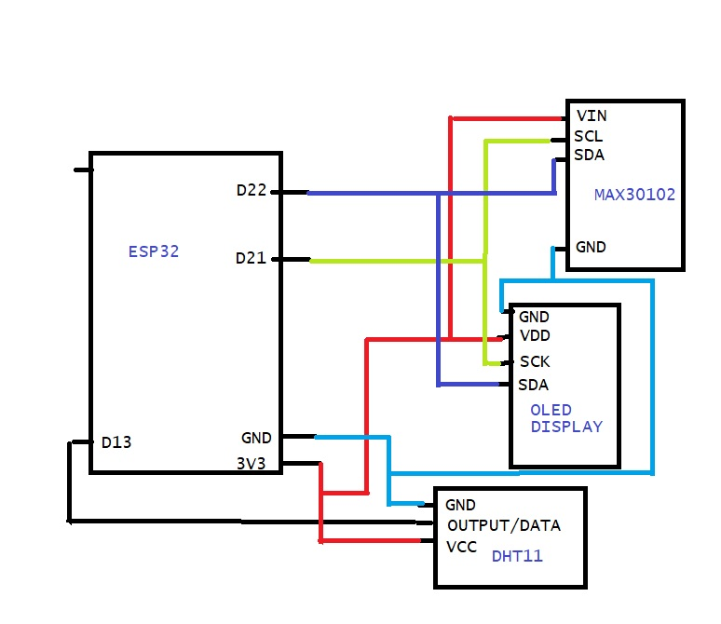
Circuit diagram of the proposed system

Slide 6
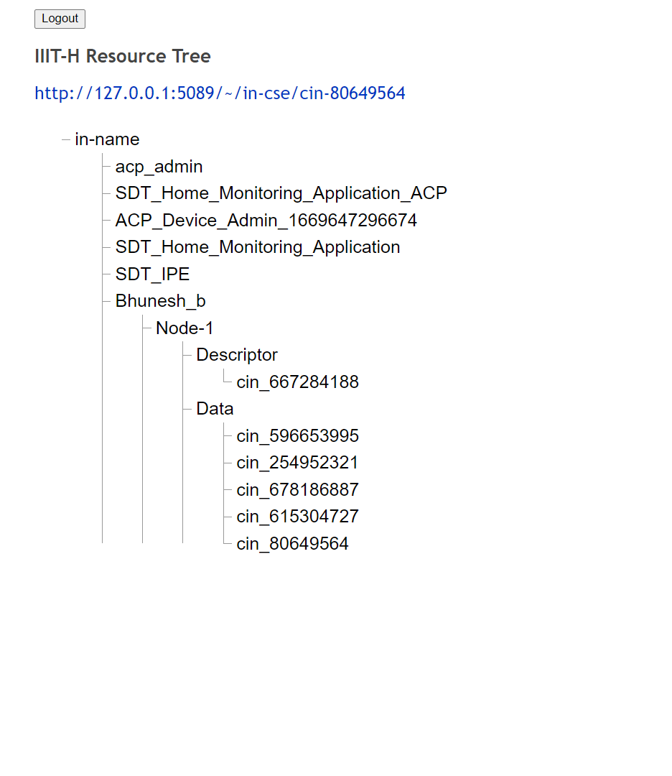
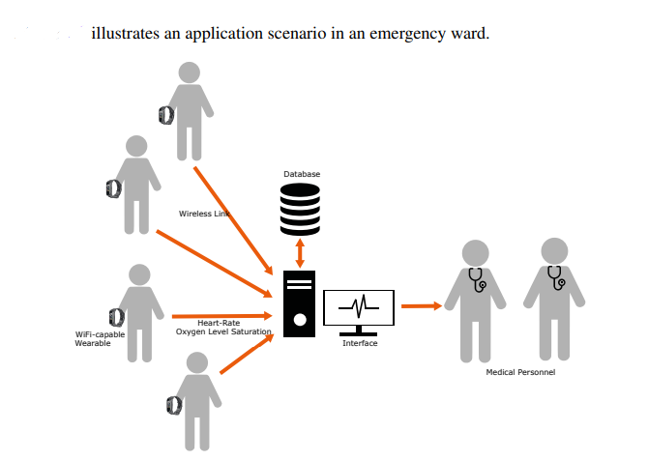

Proposed oneM2M resource tree diagram
Patient_data
The data will contain room temperature and pulse oxygen content and heart rate.

Slide 7
Tentative ways to validate the implementation (data)
This device can be used as wearable device of which data will be sent in equal intervals to om2m and web dashboard.
This device can be set as a proper unit for regular checkup of where patients can just keep their finger which would calculate heart rate Oxygen content and live room temperature
The data collected will help in analysing the condition responsible for emergency cases and condition that support in improving health .

Slide 8
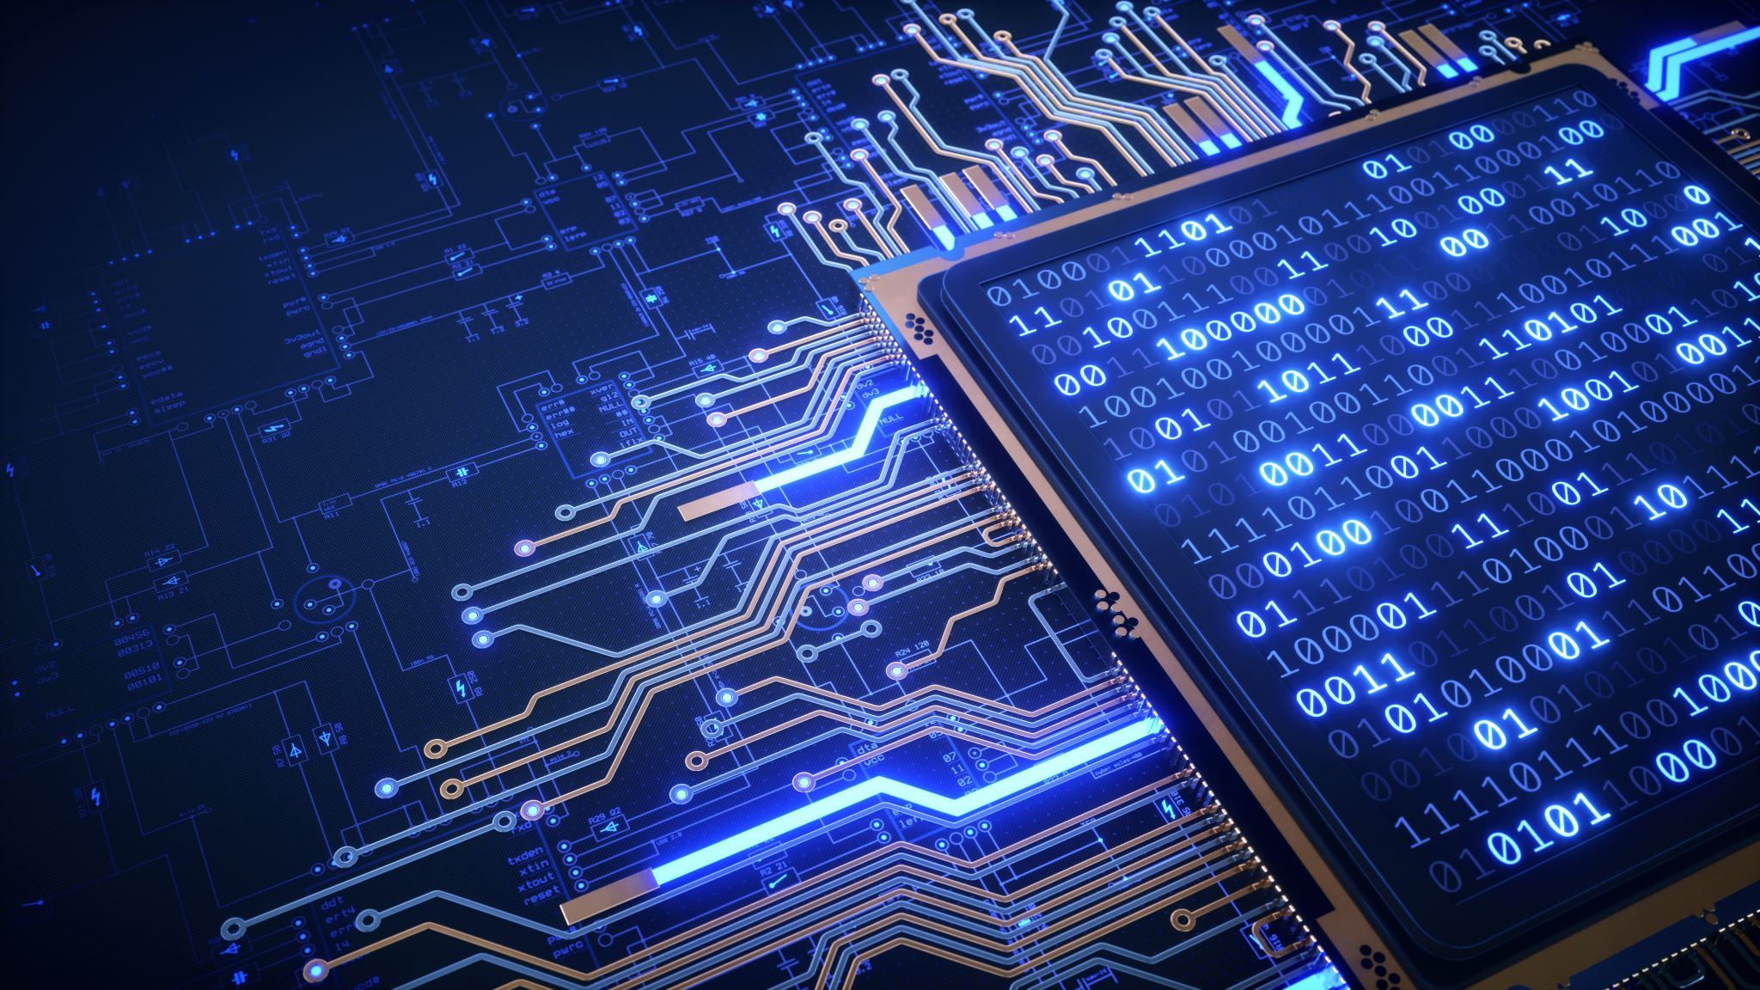
How do you plan to go about it?
I plan to Make a finished product portable enough to be worn by any person.
Program it with WIFI access credential of wearer.
Then the data will be collected and shown on web dashboard.
The data will be uploaded on om2m live.

Slide 9

Timeline of the implementation
#3 Days – Coding
#1 Day – Interfacing and Troubleshooting
#1 Day – Testing and Debugging
#3 Days – Making Web dashboard and GUI
#1 day – Final implementation

